Slide 1



HOSTED BY

Slide 2


Constructive Culture Keeps Turnover Ridiculously Low & Improves Financial, Quality & Team Performance
January 25, 2017
Scott W. Goodspeed, DHA, FACHE
Director

Slide 3

Real Culture

Slide 4
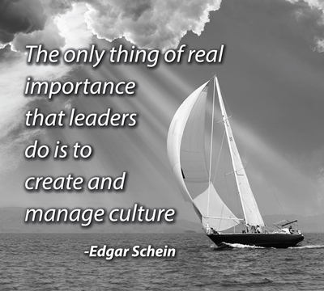
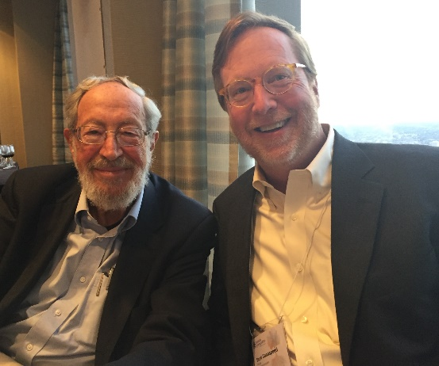
The Concept of Culture: Edgar Schein

Slide 5
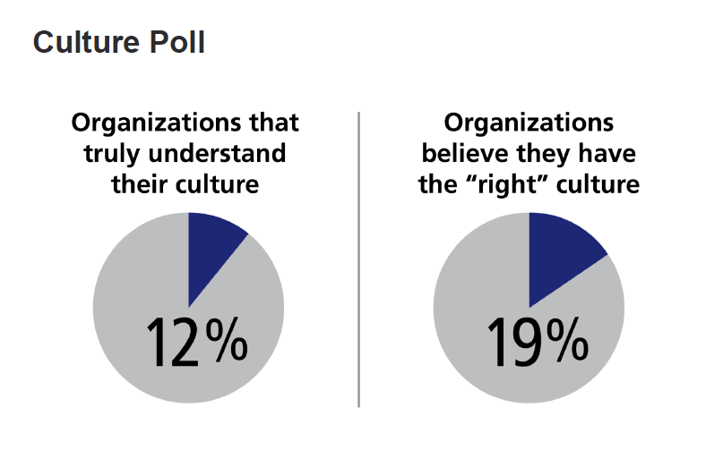
Culture Is Not Widely Understood
Source: 2016 Deloitte Human Capital Trends Report

Slide 6


Constructive Culture
SPONSORED BY

Slide 7
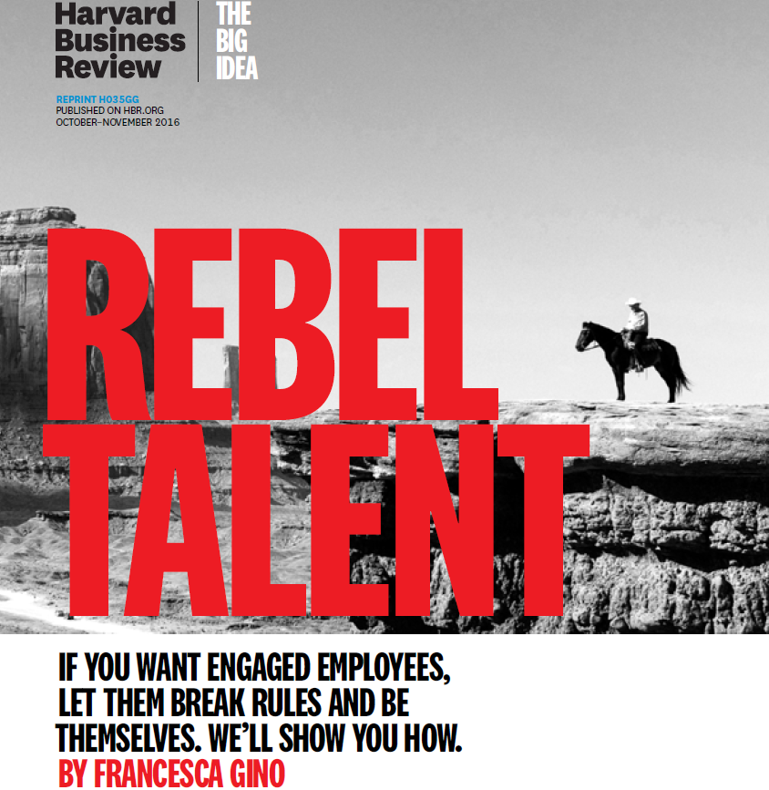
Harvard Business School Publishing October-November 2016
“In a recent survey of more than 2000 employees across a wide range of industries, nearly half the respondents reported working in organizations where they regularly feel the need to conform, and more than half said that people in their organizations do not question the status quo”.

Slide 8
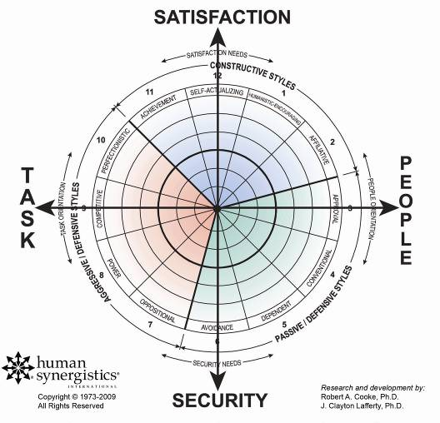
Measuring Organization Culture
The Circumplex is a highly visual and consistent throughout the Integrated Diagnostic System.
It breaks the factors underlying performance down into 12 ways or “styles” of thinking, behaving, and interacting.

Slide 9
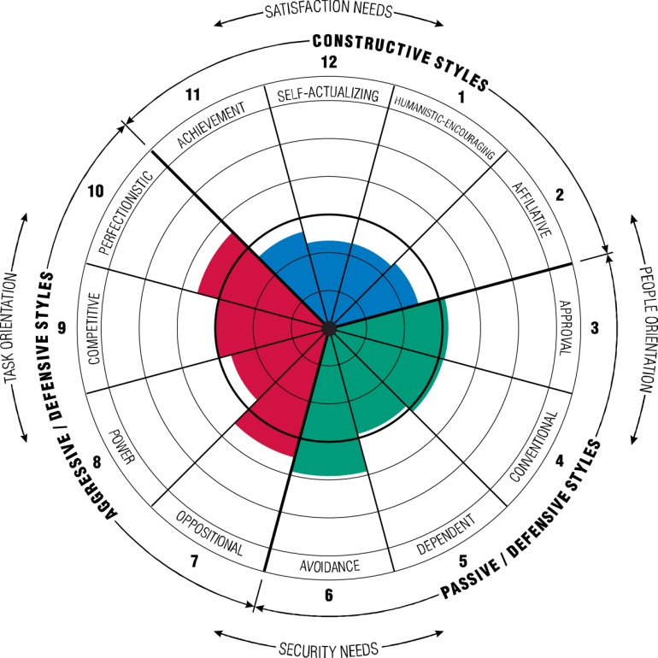
Three Types of Culture
Constructive
cultures promote effective goal setting and achievement, growth and learning, and teamwork and collaboration.
Aggressive/Defensive cultures lead to internal competition, management by exception, and short-term emphasis as opposed to long-term effectiveness.
Passive/Defensive cultures lead to conformity, rigidity, and lack of team member accountability and initiative.
Research and development by Robert A. Cooke, Ph.D. and J. Clayton Lafferty, Ph.D.
Copyright © 1973-2013 by Human Synergistics International. All Rights Reserved.

Slide 10
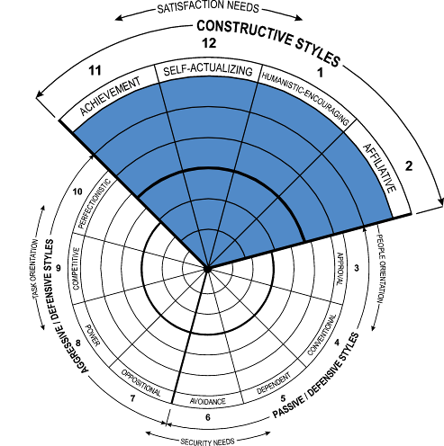
Constructive Styles
Interacting with others and approaching tasks in ways that will help them to meet their higher-order satisfaction needs
Effective organizations show STRONGER tendencies along Constructive styles
11 Achievement
Employees are expected to set realistic goals and
solve problems effectively
12 Self-Actualizing
Employees are expected to gain enjoyment from their work and produce high quality products/services
1 Humanistic-Encouraging
Employees are expected to be supportive, constructive, and open to influence in dealing with others
2 Affiliative
Employees are expected to be friendly, open, and sensitive to the satisfaction of the work group
Organizational
sustainability
through members
“doing good”
Research and development by Robert A. Cooke, Ph.D. and J. Clayton Lafferty, Ph.D.
Copyright © 1973-2013 by Human Synergistics International. All Rights Reserved.
10
Notes:
Each organization, team and individual exhibits a unique combination of styles. Effective organizations, teams and individuals show stronger tendencies along these constructive styles.

Slide 11
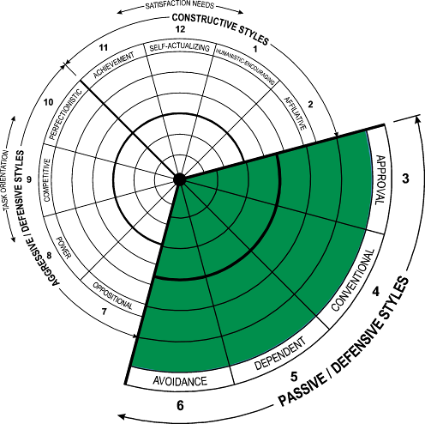
Passive/Defensive Styles
Interacting with people in ways that will not threaten their own security
Effective
organizations show WEAKER
tendencies along
Passive/Defensive styles
3 Approval
Employees are expected to agree with,
gain the approval of, and be liked by others
4 Conventional
Employees are expected to conform,
follow the rules, and make a good impression
5 Dependent
Employees are expected to do what they are
told and clear all decisions with supervisors
6 Avoidance
Employees are expected to shift responsibilities to others and avoid being blamed for mistakes
Organizational
vulnerability
through members
“being good”
Research and development by Robert A. Cooke, Ph.D. and J. Clayton Lafferty, Ph.D.
Copyright © 1973-2013 by Human Synergistics International. All Rights Reserved.
11
Notes:
Effective organizations, teams and individuals show weaker tendencies across these Passive/Defensive Styles. We have all experienced these types of expectations in organizations and the related behaviors. There’s an emphasis on “being good” with these styles.

Slide 12
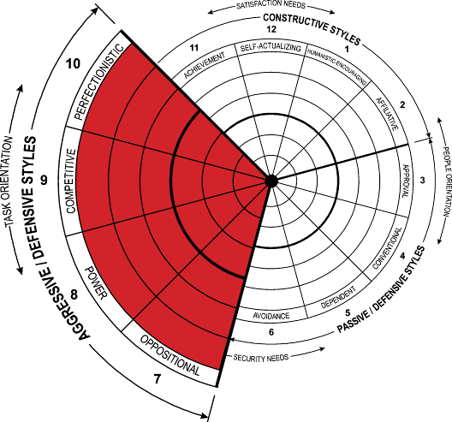
Aggressive/Defensive Styles
Approaching tasks in forceful ways to protect their status and security
Effective organizations
show WEAKER tendencies along Aggressive/Defensive styles
7 Oppositional
Employees are expected to gain status and influence by being critical and constantly challenging one another
8 Power
Employees are expected to take charge and
“control” others, and make decisions
autocratically
9 Competitive
Employees are expected to operate in a “win-lose” framework and work against their peers to be noticed
10 Perfectionistic
Employees are expected to avoid making mistakes, work long hours, and keep “on top” of everything
Organizational volatility
through members
“looking good”
Research and development by Robert A. Cooke, Ph.D. and J. Clayton Lafferty, Ph.D.
Copyright © 1973-2013 by Human Synergistics International. All Rights Reserved.
12
Notes:
Effective organizations, teams and individuals also show weaker tendencies across these Agressive/Defensive Styles. Some people actually view these styles as positive but they are not the key to sustainable results since members focus more on “looking good” than delivering sustainable results as a team.

Slide 13
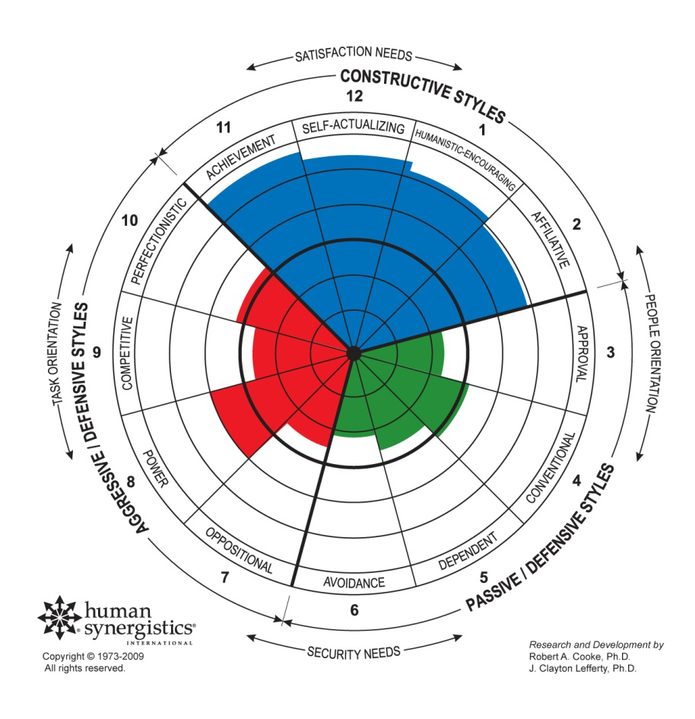
Impact of the Most Effective and Successful Leaders

Slide 14
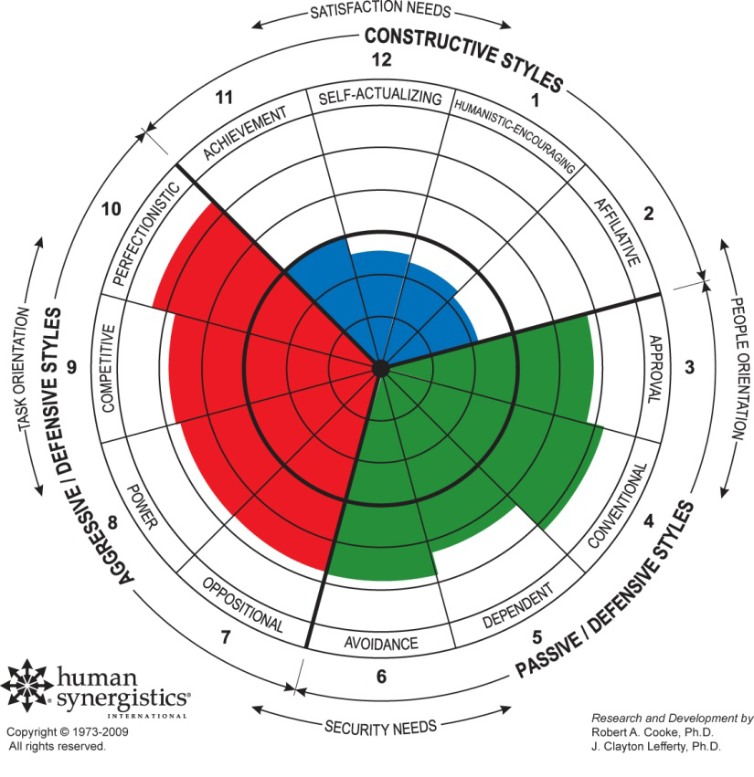
Impact of the Least Effective and Successful Leaders

Slide 15
Emphasis on Praise and Criticism
Emphasis on Praise
(n=12)
Emphasis on Criticism
(n=16)

Slide 16
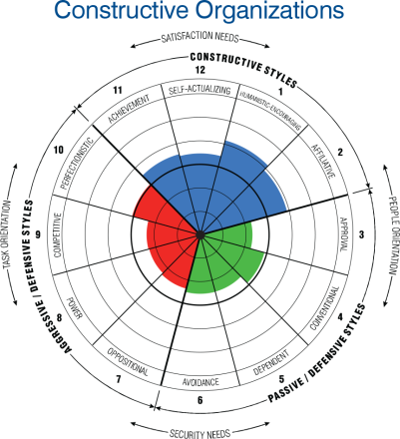
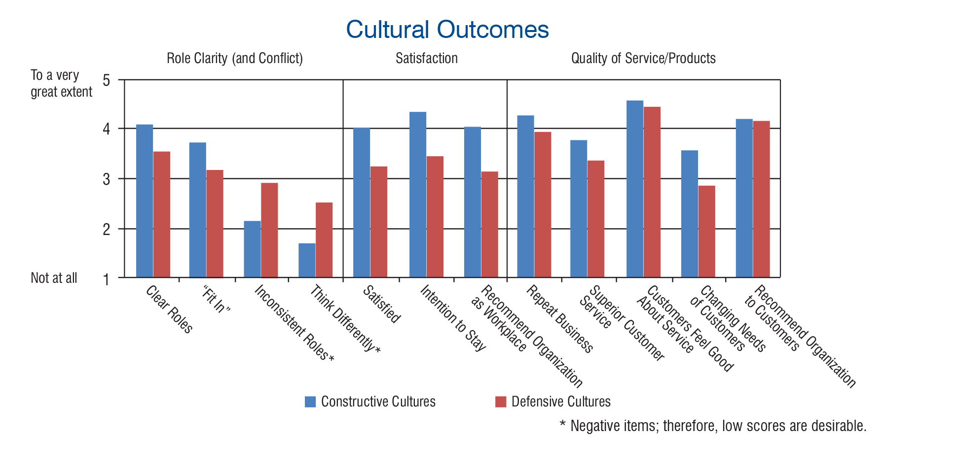
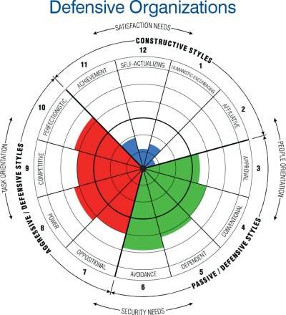
Industry Profiles—Healthcare

Slide 17
15 Years of Engagement Emphasis-Isolated Progress & Limited Impact
32% of U.S. employees engaged in 2015
Monthly averages largely consistent
Engagement flat since 2000

Slide 18
Key Learnings
Both research and my own professional experience suggest that constructive norms and expectations lead to ridiculously low turnover and improved financial, quality and team performance.
Turnover, financial performance, quality and teamwork are leadership and management phenomena and not an organizational occurrence.
Leaders and managers impact people and culture directly.
What leaders and managers do and how they do it determine the impact that they have on the people around them.

Slide 19

Approaching the Human Side of the Business:
A Community Hospital
SPONSORED BY

Slide 20
The Iceberg of Ignorance

Slide 21
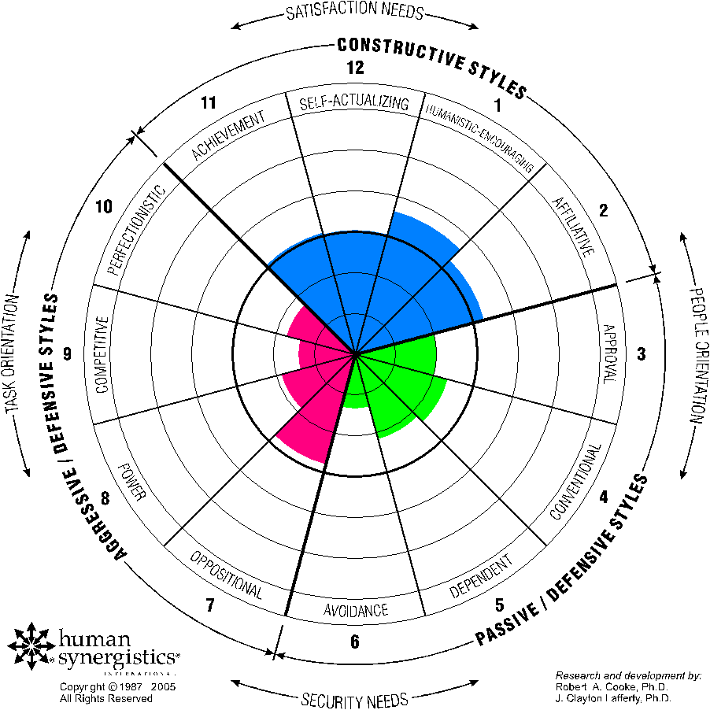
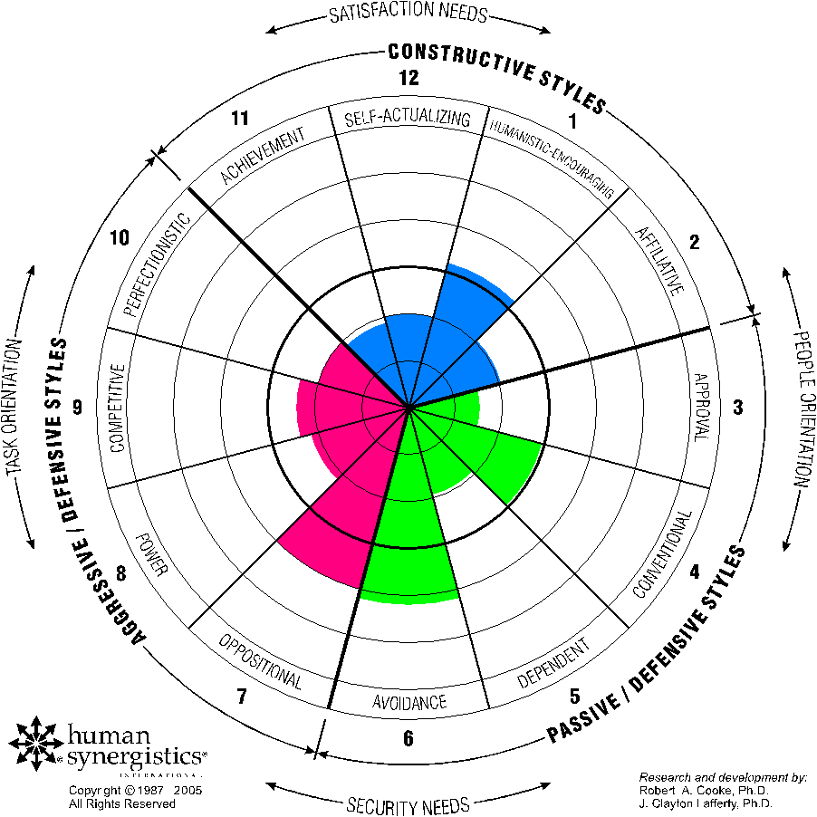
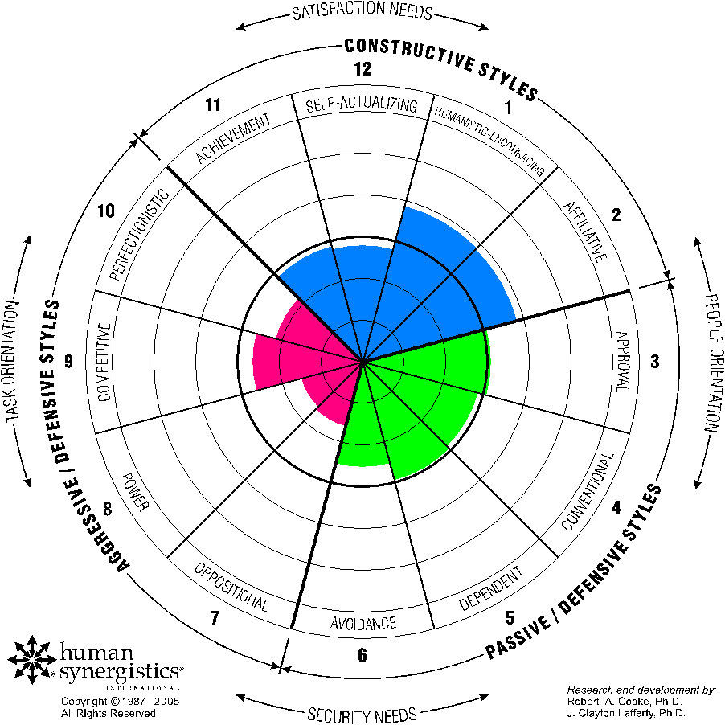
The Organization
Board
Executive Team
Providers
Department Managers
Front Line Employees
Research and Development by: Robert A. Cooke, Ph.D. and Janet L. Szumal, Ph.D.

Slide 22






The Complexity of True Culture
Constructive
Passive
Aggressive
ORGANIZATIONS
Organizational Culture Inventory® (OCI®)
TEAMS
Group Styles Inventory™ (GSI)
LEADERSHIP
Leadership/Impact® (L/I)
MANAGEMENT
Management/Impact® (M/I)
INDIVIDUALS
Life Styles Inventory™ (LSI)
Notes:
Behaviors / styles differ across levels and across individuals. This organization is dramatically different than the next example.

Slide 23
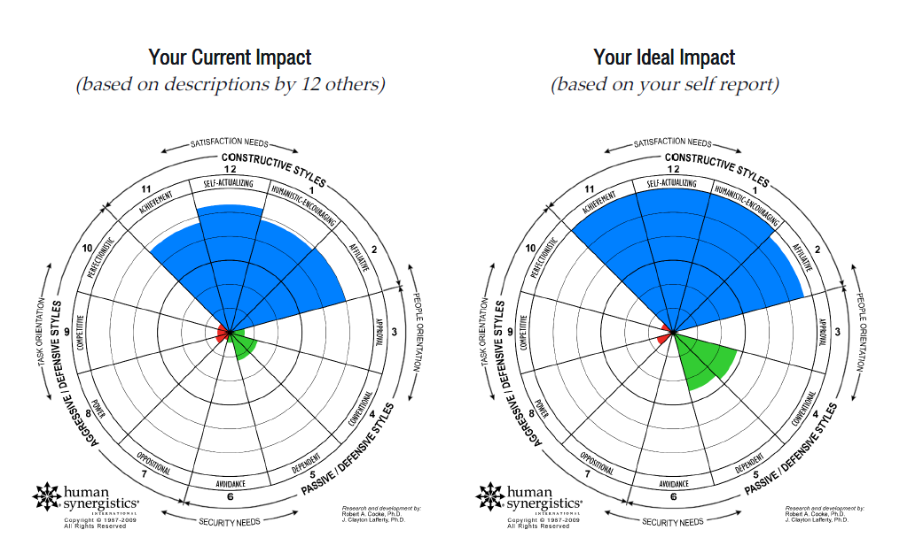
Joe’s Management Impact

Slide 24
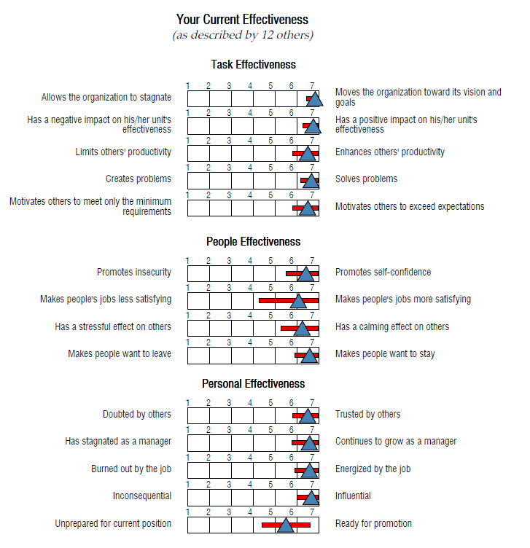
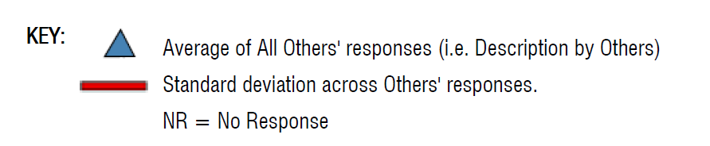
Joe’s Management Impact

Slide 25
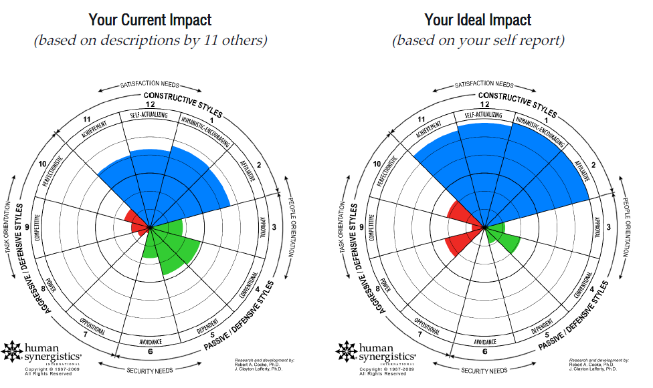
Tysha’s Management Impact

Slide 26
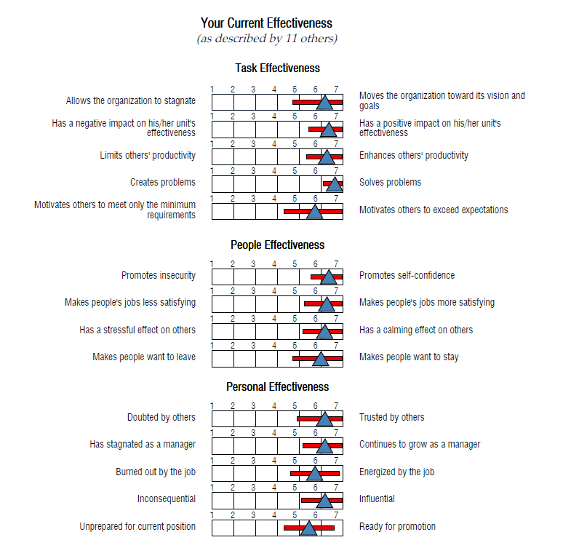
Tysha’s Management Impact

Slide 27
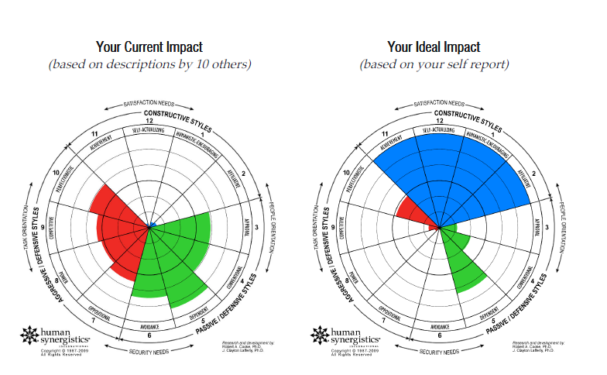
Brad’s Management Impact

Slide 28
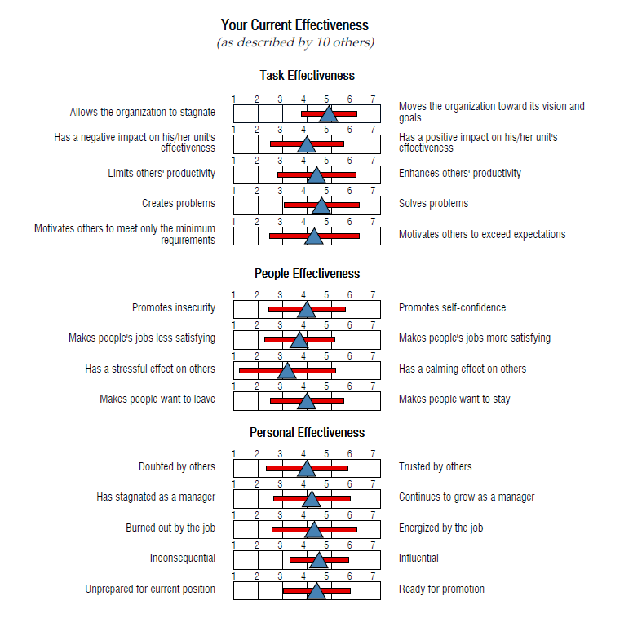
Brad’s Management Impact

Slide 29

What Is Joe and Tysha’s Management Impact Related to Turnover?
SPONSORED BY

Slide 30
Management Action to Reduce Turnover
Joe and Tysha’s Management Impact is constructive: High task, people and personal effectiveness
They go outside of the norm to do what's right
Hire for attitude
Specific process for screening and onboarding
Trusted leadership
Clear goals
Behavior norms translated from values
Hands-on management
Create inclusion
Real-time recognition
Open for opportunities for improvement
Serious about learning and teaching continuously

Slide 31
Management Action to Reduce Turnover
Less than 2% turnover over five years for Joe and Tysha
State turnover rate 17% and Organization turnover rate 22%
Leadership matters
Culture and leadership are 3X more important than salary in your employment brand
Career development and learning are almost 2X more important than compensation, benefits and work environment
What is Brad’s Management Impact?

Slide 32
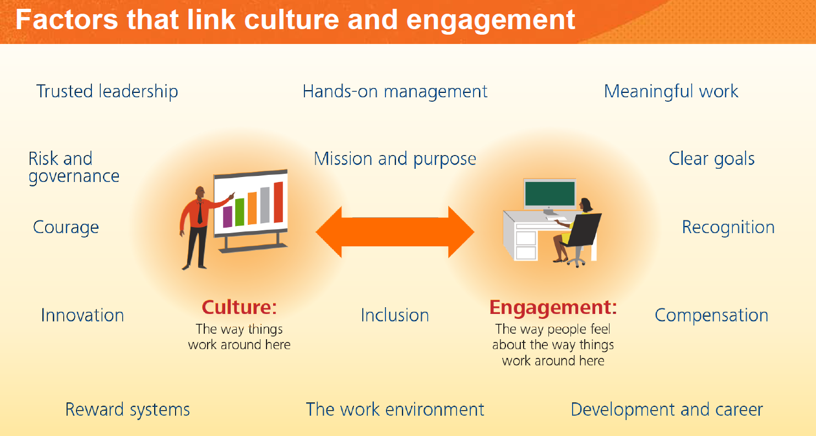
Culture and Engagement

Slide 33
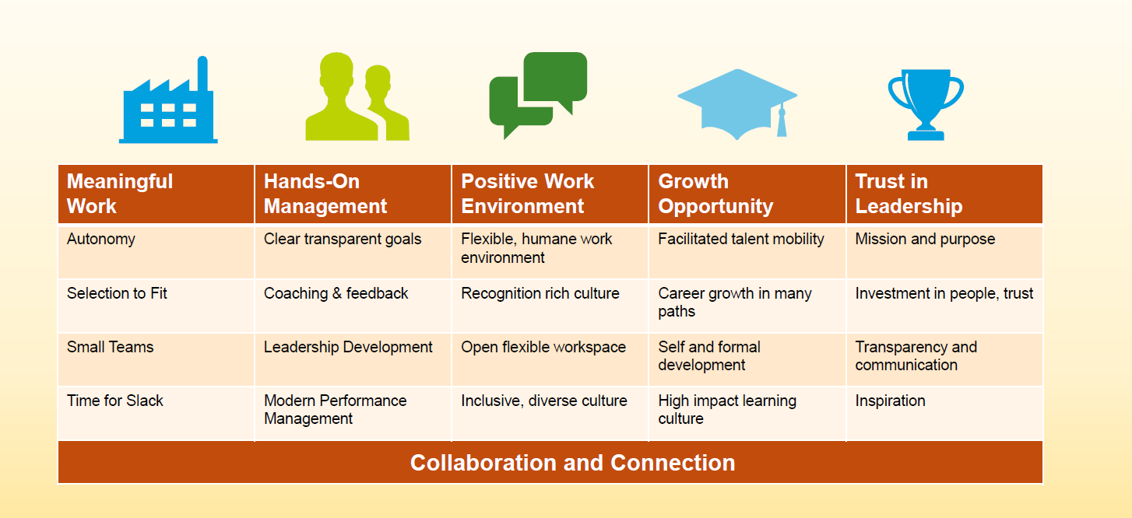
Culture and Engagement

Slide 34

Board Culture
SPONSORED BY

Slide 35
This Board Sets Tone and Creates the Culture
Board
Outcomes are better in hospitals where:
  The board spends >25% of its time on quality and safety.
  The board receives a formal quality measurement report.
  There is a high level of interaction between the board and medical staff on quality strategy.
  Senior executive compensation is based in part on quality and safety performance.
  The CEO is identified as the person with the greatest impact on QI, especially when so identified by the QI executive.
  Vaughn T, Koepke M, Kroch E, et al. Journal of Patient Safety. 2006; 2:2-9
  Boards can make a difference, but boards themselves can not make it happen; they can only create the climate and culture to increase the probability quality happens, is nurtured, celebrated and continuously refined.
  Boards Matter for a Culture of Quality and Safety

Slide 36

Key Takeaways
SPONSORED BY

Slide 37
Key Takeaways
Measure current organizational culture—ideal and current
Assess both leadership and management impact and debrief
Create an action plan including
  Develop behavior standards
  Develop a physician compact
  Reorganize and empower management
  Leadership and management training including individual coaching
  Enhanced communication methods, performance management and reward and recognition
Create a Balanced Scorecard with key metrics
  People, infrastructure and technology (turnover)
  Quality and patient safety
  Growth and provider relations
  Financial health
Best make culture change through solving problems—strategic plan context
Sustain results with limited investment and measure culture in 18 months

Slide 38
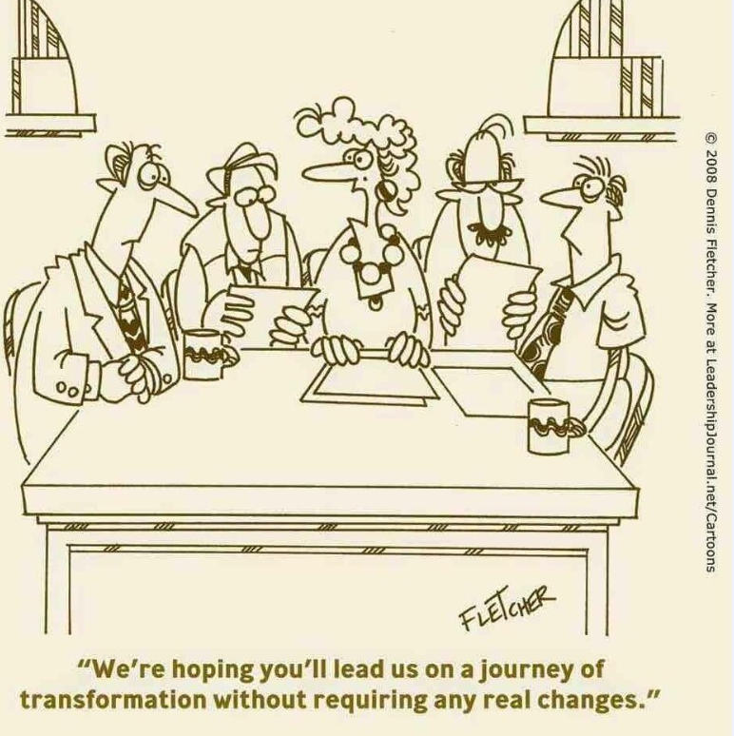
Organizational Culture and Future Success

Slide 39


www.stroudwater.com
Core Team and Key Dates

Slide 40
Scott W. Goodspeed
Director
sgoodspeed@stroudwater.com
50 Sewall Street, Suite 102
Portland, Maine 04102
(207) 272-9934
www.stroudwater.com
SPONSORED BY

Slide 41
THANK YOU
FOR ATTENDING
Let’s Talk About Your Staff Training Needs
terryk@litmos.com----717-598-8970

Slide 42
Reference Material
SPONSORED BY

Slide 43
The Concept of Culture: Edgar Schein
Culture is an abstraction, yet the forces that are created in social and organizational situations deriving from culture are powerful. If we don’t understand the operation of these forces, we become victim to them.
Cultural forces are powerful because they operate outside of our awareness. We need to understand them not only because of their power but also because they help to explain many of our puzzling and frustrating experiences in social and organizational life.
Most importantly, understanding cultural forces enables us to understand ourselves better.
Schein, Edgar H. (2010). Organizational Culture and Leadership (The Jossey-Bass Business & Management Series) (p. 7). Wiley. Kindle Edition.

Slide 44
The Concept of Culture: Edgar Schein
How is it possible that in a practice, the doctors, nurses, and administrators are often fighting with each other rather than collaborating to improve patient care?
How is it possible that employees are encouraged to report unsafe practices, yet the organization continues to experience a major accident?
How is it possible that the best strategic options for a healthcare organization never get implemented, leaving the organization to inevitable failure?
How is it possible when the new CEO arrives the employees “hunker down” and don’t “want change”?
If we understand the dynamics of culture, we will be less likely to be puzzled, irritated, and anxious when we encounter the unfamiliar and seemingly irrational behavior of people in organizations.
Schein, Edgar H. (2010). Organizational Culture and Leadership (The Jossey-Bass Business & Management Series) (p. 9). Wiley. Kindle Edition.

Slide 45
The Concept of Culture: Edgar Schein
Perhaps the most intriguing aspect of culture as a concept is that it points us to phenomena that are below the surface, that are powerful in their impact but invisible and to a considerable degree unconscious.
In another sense, culture is to a group what personality or character is to an individual. We can see the behavior that results, but we often cannot see the forces underneath that cause certain kinds of behavior.
Culture as a concept is thus an abstraction. If an abstract concept is to be useful to our thinking, it should be observable yet increase our understanding of a set of events that are otherwise mysterious or not well understood.
Schein, Edgar H. (2010). Organizational Culture and Leadership (The Jossey-Bass Business & Management Series) (p. 14). Wiley. Kindle Edition.

Slide 46
Culture Formally Defined
The culture of a group can now be defined as a pattern of shared basic assumptions learned by a group as it solved its problems of external adaptation and internal integration, which has worked well enough to be considered valid and, therefore, to be taught to new members as the correct way to perceive, think, and feel in relation to those problems.
The bottom line for leaders is that if they do not become conscious of the cultures in which they are embedded, those cultures will manage them. Cultural understanding is desirable for all of us, but it is essential to leaders if they are to lead.
Schein, Edgar H. (2010). Organizational Culture and Leadership (The Jossey-Bass Business & Management Series) (p. 18). Wiley. Kindle Edition.

Slide 47
The Three Levels of Culture
Artifacts (dysfunctional meetings, new task forces)
Visible and feelable structures and processes
Observed behavior, difficult to decipher
Espoused Beliefs and Values (personal responsibility, do the right thing, get buy-in from those implementing decisions, fight bitterly in meetings yet be friends, real teamwork)
Ideals, goals, values, aspirations
Ideologies
Rationalizations—May or may not be congruent with behavior and other artifacts
Basic Underlying Assumptions (the best way to fit is to go along to get along, accuracy and truth are more important than speed)
Unconscious, taken-for-granted beliefs and values
  Determine behavior, perception, thought, and feeling
Schein, Edgar H. (2010). Organizational Culture and Leadership (The Jossey-Bass Business & Management Series) (p. 24). Wiley. Kindle Edition.

Slide 48
Culture Fundamentals: 9 Insights from Edgar Shine
Culture is a result of what an organization has learned from dealing with problems and organizing itself internally.
  Culture is the sum total an organization has learned in dealing with external problems, which would be goals, strategy and how we do things and how it organizes itself internally.
Culture matters to the extent an organization is adaptive.
  If it’s adaptive, it doesn’t matter much, people don’t notice. If it’s not adaptive, it matters a lot.
Do not over-simplify culture. Its far more than “how we do things around here.”
  Culture operates at many levels. “How we do things around here” is at the surface level. The explanation of why we do things forces you to look at the root system.

Slide 49
Culture Fundamentals: 9 Insights from Edgar Shine
Leaders should not focus on culture change. Focus on a business problem.
  Ask what do you mean by culture and what do you think you need to change?
Your culture always helps and hinders problem-solving.
  There are always parts of the culture that help solve the problem and other parts that get in the way. Then you are finally at the point of saying, well maybe I need a culture change, but you got there by thinking about the business problem you are trying to solve.
  Be very specific about behavior, how its impacting your problem and the future state of the behavior you want to see.
  The key is to be very specific. Ask: if we solve this problem, what’s the behavior look like a year from now?

Slide 50
Culture Fundamentals: 9 Insights from Edgar Shine
Culture is a group phenomenon. Engage focus groups to define how the culture is helping and hindering work on a problem.
  Let’s look at our culture from the point of view of what it is and how it is going to help and how it is going to hinder, but always in the context of what we are trying to do, e.g. collaborative salesforce.
Solve problems by identifying and resolving associated discrepancies between values and behavior.
  The discrepancy between the values and the behavior is what forces you into looking at the root system, and you discover we have always been individualistic.
  Don’t focus on culture because it can be a bottomless pit. Again, get groups involved in solving problems.
  www.cultureuniversity.com

